Slide 1
Mean Field Methods for Computer and Communication Systems: A Tutorial
Jean-Yves Le Boudec
EPFL
Performance 2010
Namur, November 16-19 2010

Slide 2

References
published Oct 2010
perfeval.epfl.ch

Slide 3
Contents
Mean Field Interaction Model
Finite Horizon
The Mean Field Limit
Convergence to Mean Field
Random process modulated by Mean field limit
Stationary regime
Stationary Regime of Mean Field Limit
Critique of the Fixed Point Method
Reversible Case
Optimization

Slide 4
Mean Field interaction Model

Slide 5
Common Assumptions
Time is discrete or continuous
N objects
Object n has state X_{n}(t)
(X^{N}₁(t), …, X^{N}_{N}(t)) is Markov => M^{N}(t) = occupancy measure process is also Markov
Objects can be observed only through their state
N is large
Called “Mean Field Interaction Models” in the Performance Evaluation community [McDonald(2007), Benaïm and Le Boudec(2008)]

Slide 6
Intensity I(N)
I(N) = expected number of transitions per object per time unit
The mean field limit occurs when we re-scale time by I(N) i.e. we consider X^{N}(t/I(N))
If time is discrete for X^{N}
I(N) = O(1): mean field limit is in discrete time [Le Boudec et al (2007)]
I(N) = O(1/N): mean field limit is in continuous time [Benaïm and Le Boudec (2008)]

Slide 7
Example: 2-Step Malware
Mobile nodes are either
`S’ Susceptible
`D’ Dormant
`A’ Active
Time is discrete
Nodes meet pairwise (bluetooth)
One interaction per time slot, I(N) = 1/N; mean field limit is an ODE
State space is finite = {`S’ , `A’ ,`D’}
Occupancy measure is M(t) = (S(t), D(t), A(t)) with S(t)+ D(t) + A(t) =1
S(t) = proportion of nodes in state `S’ [Benaïm and Le Boudec(2008)]
Possible interactions:
Recovery
D -> S
Mutual upgrade
D + D -> A + A
Infection by active
D + A -> A + A
Recovery
A -> S
Recruitment by Dormant
S + D -> D + D
Direct infection
S -> D
Direct infection
S -> A

Slide 8
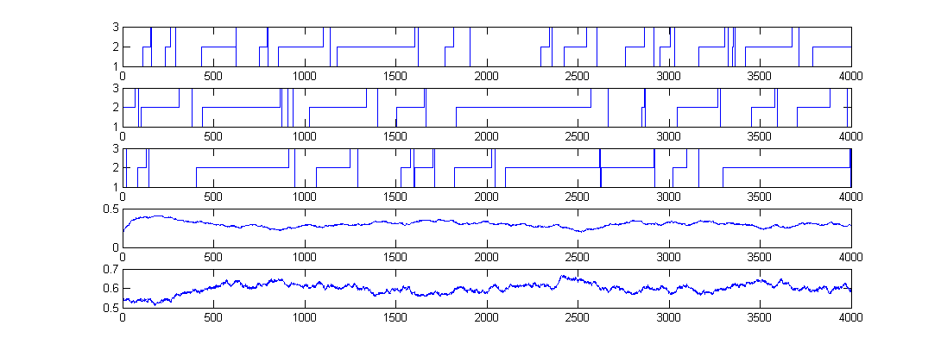
Simulation Runs, N=1000 nodes
Node 1
State = D
State = A
State = S
Node 2
Node 3
D(t)
Proportion of nodes
In state i=1
A(t)
Proportion of nodes
In state i=2

Slide 9
Sample Runs with N = 1000

Slide 10
Example: WiFi Collision Resolution Protocol
N nodes, state = retransmission stage k
Time is discrete, I(N) = 1/N; mean field limit is an ODE
Occupancy measure is M(t) = [M₀(t),...,M_{K}(t)] with M_{k}(t) = proportion of nodes at stage k
[Bordenave et al.(2008)Bordenave, McDonald, and Proutiere, Bordenave et al.(2007)Bordenave, McDonald, and Proutiere]

Slide 11
Example: TCP and ECN
[Tinnakornsrisuphap and Makowski(2003)] At, every time step, all connections update their state: I(N)=1
Time is discrete, mean field limit is also in discrete time (iterated map)
Similar examples: HTTP Metastability [Baccelli et al.(2004)Baccelli, Lelarge, and McDonald] Reputation System [Le Boudec et al.(2007)Le Boudec, McDonald, and Mundinger]
ECN Feedback q(R(t))
1
n
ECN router
queue length R(t)
N
N connections

Slide 12
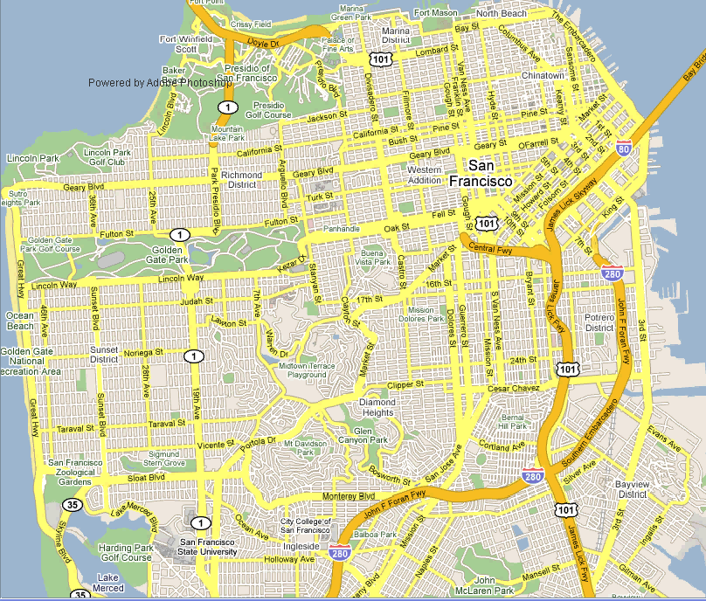
Example: Age of Gossip

Slide 13
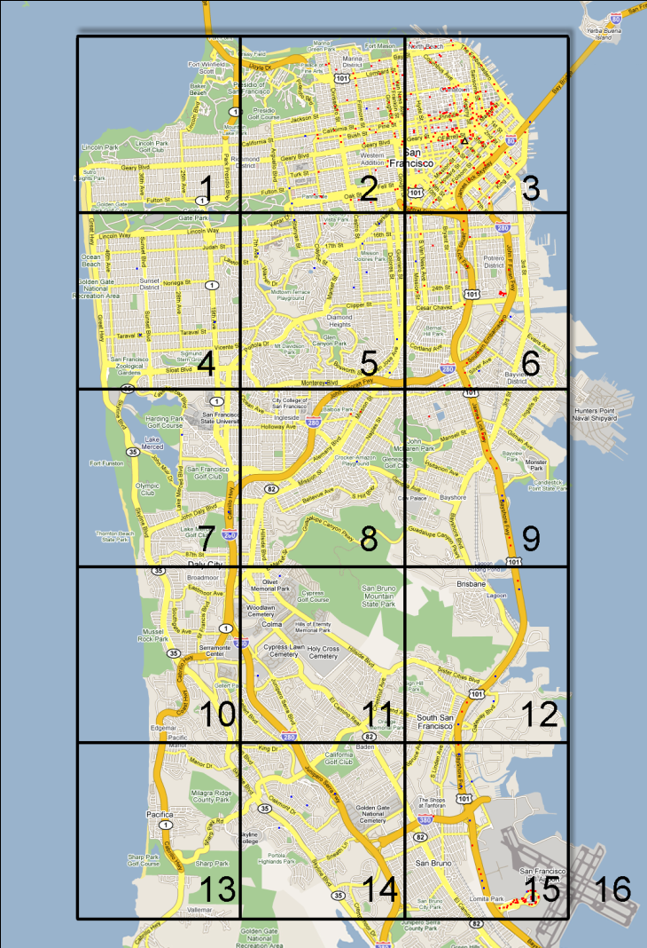
Example: Age of Gossip
Mobile node state = (c, t) c = 1 … 16 (position)
t ∊ R⁺ (age)
Time is continuous, I(N) = 1
Occupancy measure is F_{c}(z,t) = proportion of nodes that at location c and have age ≤ z [Chaintreau et al.(2009)]

Slide 14
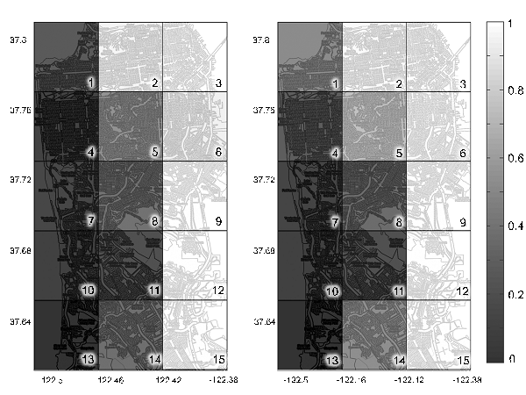
Spatial Representation
Comparison between
the mean-field limit and
the trace. Percentages
of mobile nodes in
classes 1-15 with age
z<20mn at time t=300mn
(1 p.m.).

Slide 15
The Importance of Being Spatial
We compare the previous 16 class case with a simple 2 class case (C=2)
The first figure suggests that for the case C=16, trace and MF data samples come from the same distribution
For the case C=2 we observe the strong bias present for both low and high age
QQ plots, comparing the age distribution of
trace data and data artificially obtained from
the mean-field CDF, for 16 class and 2 class
scenarios. Time period observed 5 p.m.-6 p.m.

Slide 16
Extension to a Resource
Model can be complexified by adding a global resource R(t)
Slow: R(t) is expected to change state at the same rate I(N) as one object -> call it an object of a special class
Fast: R(t) is change state at the aggregate rate N I(N) -> requires special extensions of the theory
[Bordenave et al.(2007)Bordenave, McDonald, and Proutiere] [Benaïm and Le Boudec(2008)]

Slide 17
What can we do with a Mean Field Interaction Model ?
Large N asymptotics
= fluid limit
Markov chain replaced by a deterministic dynamical system
ODE
Fast Simulation
Issues
When valid
Don’t want do devote an entire PhD to show mean field limit
How to formulate the ODE
Large t asymptotic
≈ stationary behaviour
Useful performance metric
Issues
Is stationary regime of ODE an approximation of stationary regime of original system ?
Does this justify the “Decoupling Assumption”?

Slide 18
MEAN FIELD LIMIT
FINITE HORIZON

Slide 19
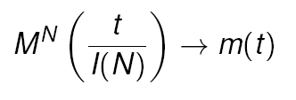
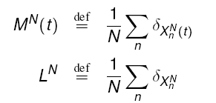
The Mean Field Limit
Under very general conditions (given later) the occupancy measure converges, in some sense, to a deterministic process, m(t), called the mean field limit
[Graham and Méléard(1994)] consider the occupancy measure L^{N} in path space

Slide 20
Mean Field Limit
N = +∞
Stochastic
system
N = 1000

Slide 21
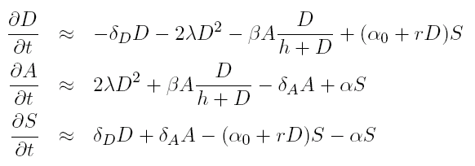
Mean Field Limit Equations
Recovery
D -> S
Mutual upgrade
D + D -> A + A
Infection by active
D + A -> A + A
Recovery
A -> S
Recruitment by Dormant
S + D -> D + D
S -> D
Direct infection
S -> A

Slide 22
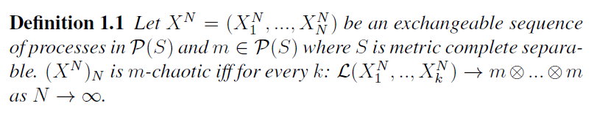
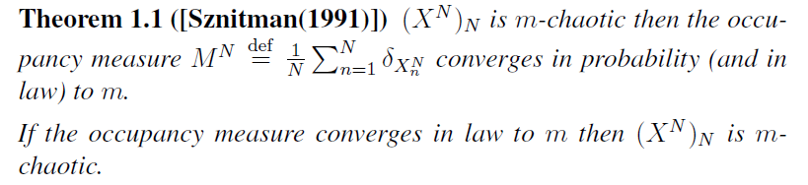
Propagation of Chaos is Equivalent to Convergence to a Deterministic Limit

Slide 23
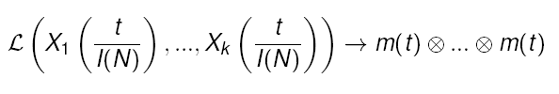
Propagation of Chaos Decoupling Assumption
(Propagation of Chaos) If the initial condition (X^{N}_{n} (0))_{n=1…N} is exchangeable and there is mean field convergence then the sequence (X^{N}_{n})_{n=1…N} indexed by N is m-chaotic k objects are asymptotically independent with common law equal to the mean field limit, for any fixed k
(Decoupling Assumption) (also called Mean Field Approximation, or Fast Simulation) The law of one object is asymptotically as if all other objects were drawn randomly with replacement from m(t)

Slide 24
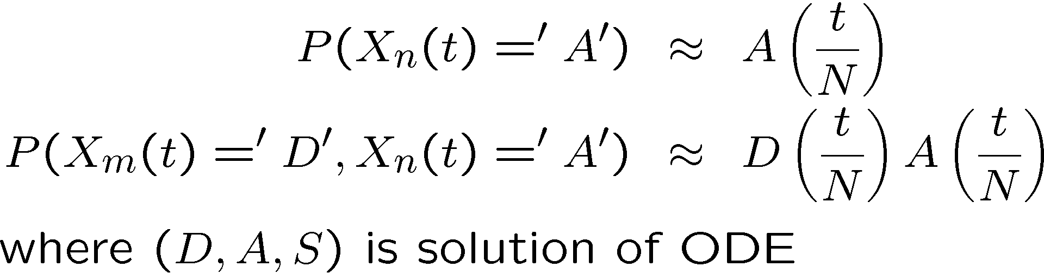
Example: Propagation of Chaos
At any time t
Thus for large t :
Prob (node n is dormant) ≈ 0.3
Prob (node n is active) ≈ 0.6
Prob (node n is susceptible) ≈ 0.1

Slide 25
The Two Interpretations of the Mean Field Limit
m(t) is the approximation for large N of
the occupancy measure M^{N}(t)
the state probability for one object at time t, drawn at random among N

Slide 26
The Mean Field Approximation
Common in Physics
Consists in pretending that X^{N}_{m}(t), X^{N}_{n}(t) are independent in the time evolution equation
It is asymptotically true for large N, at fixed time t, for our model of interacting objects, when convergence to mean field occurs.
Also called “decoupling assumption” (in computer science)

Slide 27
Convergence to Mean Field Limit
FINITE HORIZON

Slide 28


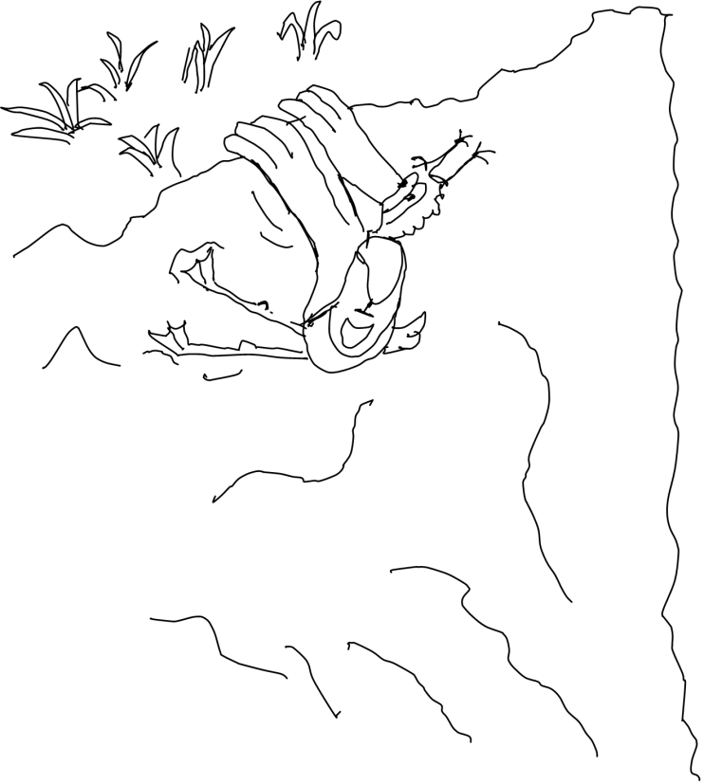
The General Case
Convergence to the mean field limit is very often true
A general method is known [Sznitman(1991)]:
Describe original system as a markov system; make it a martingale problem, using the generator
Show that the limiting problem is defined as a martingale problem with unique solution
Show that any limit point is solution of the limitingmartingale problem
Find some compactness argument (with weak topology)
Requires knowing [Ethier and Kurtz(2005)]
Never again !

Slide 29
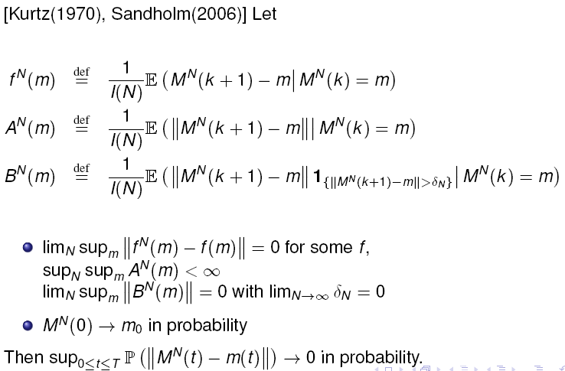
Finite State Space per Object : Kurtz’s Theorem
State space for one object is finite
Original Sytem is in discrete time and I(N) -> 0; limit is in continuous time

Slide 30
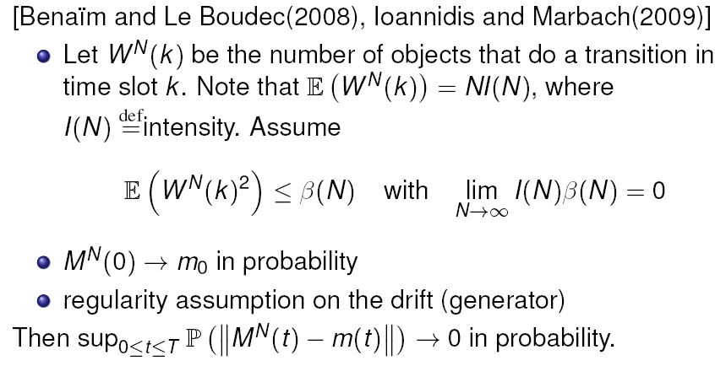
Discrete Time, Finite State Space per Object
Refinement + simplification, with a fast resource When limit is non continuous:

Slide 31
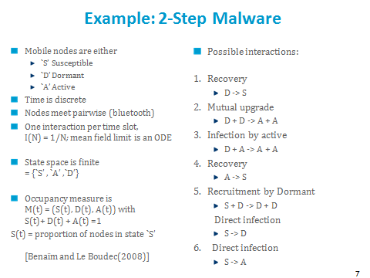
Example: Convergence to Mean Field
Rescale time such that one time step = 1/N
Number of transitions per time step is bounded by 2, therefore there is convergence to mean field

Slide 32
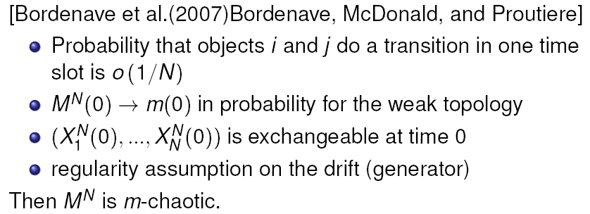
Discrete Time, Enumerable State Space per Object
State space is enumerable with discrete topology, perhaps infinite; with a fast resource
Essentially : same as previous plus exchangeability at time 0

Slide 33
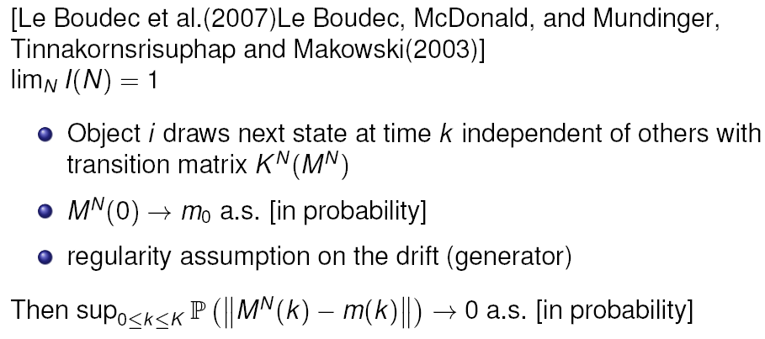
Discrete Time, Discrete Time Limit
Mean field limit is in discrete time

Slide 34
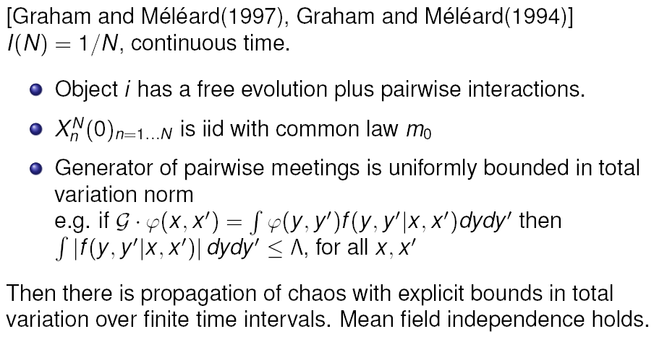
Continuous Time
« Kurtz’s theorem » also holds in continuous time (finite state space)
Graham and Méléard: A generic result for general state space (in particular non enumerable).

Slide 35
Age of Gossip
[Graham and Méléard 1997] applies, i.e. mean field convergence occurs for iid initial conditions
[Chaintreau et al.(2009)Chaintreau, Le Boudec, and Ristanovic] shows more, i.e. weak convergence of initial condition suffices
Important for non stationary cases
Every taxi has a state
Position in area c = 0 … 16
Age of last received information

Slide 36
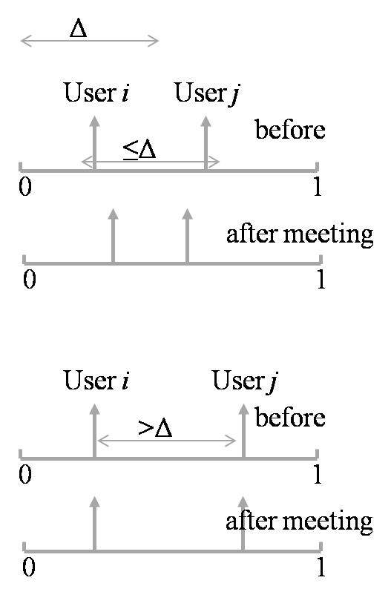
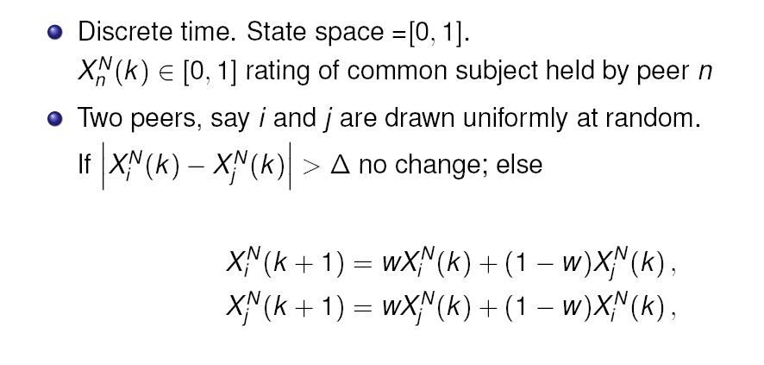
The Bounded Confidence Model
Introduced in [Deffuant et al (2000)], used in mobile networks in [Buchegger and Le Boudec 2002]; Proof of convergence to Mean Field in [Gomez, Graham, Le Boudec 2010]

Slide 37
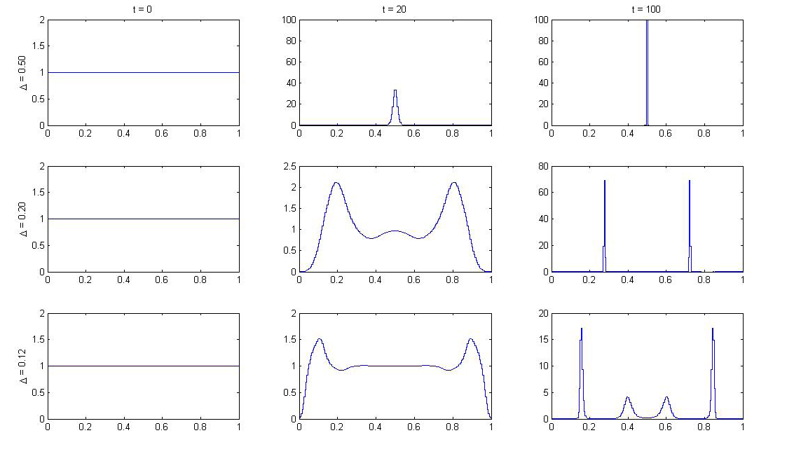
PDF of Mean Field Limit

Slide 38
Is There Convergence to Mean Field ?
Yes for the discretized version of the problem
Replace ratings in [0,1] by fixed point real nombers on d decimal places
Generic result says that mean field convergence holds (use [Benaim Le Boudec 2008], the number of meetings is upper bounded by a constant, here 2).
There is convergence for any initial condition such that M^{N}(0) -> m₀
This is what any simulation implements

Slide 39
Is There Convergence to Mean Field ?
There can be no similar result for the real version of the problem
Counter Example: M^{N}(0) -> m(0) (in the weak topology) but M^{N}(t) does not converge to m(t)
There is convergence to mean field if initial condition is iid from m₀ [Gomez et al, 2010]
M^{N}(0)
M^{N}(t₁)
Δ
t = 0
Δ
t = t₁
0
1
0
1
m(0)
m(t₁)
Δ
t = 0
Δ
t = t₁
0
1
0
1

Slide 40
Convergence to Mean Field
For the finite state space case, there are many simple results, often verifiable by inspection For example [Kurtz 1970] or [Benaim, Le Boudec 2008]
For the general state space, things may be more complex

Slide 41
RANDOM PROCESS MODULATED BY MEAN FIELD LIMIT
FINITE HORIZON

Slide 42
Fast Simulation = Random Process Modulated by Mean Field Limit
Assume we know the state of one tagged object at time 0; we can approximate its evolution by replacing all other objects collectively by the mean field limit (e.g. the ODE)
The state of this object is a jump process, with transition matrix driven by the ODE [Darling and Norris, 2008]
A stronger result than propagation of chaos – does not require exchangeability

Slide 43
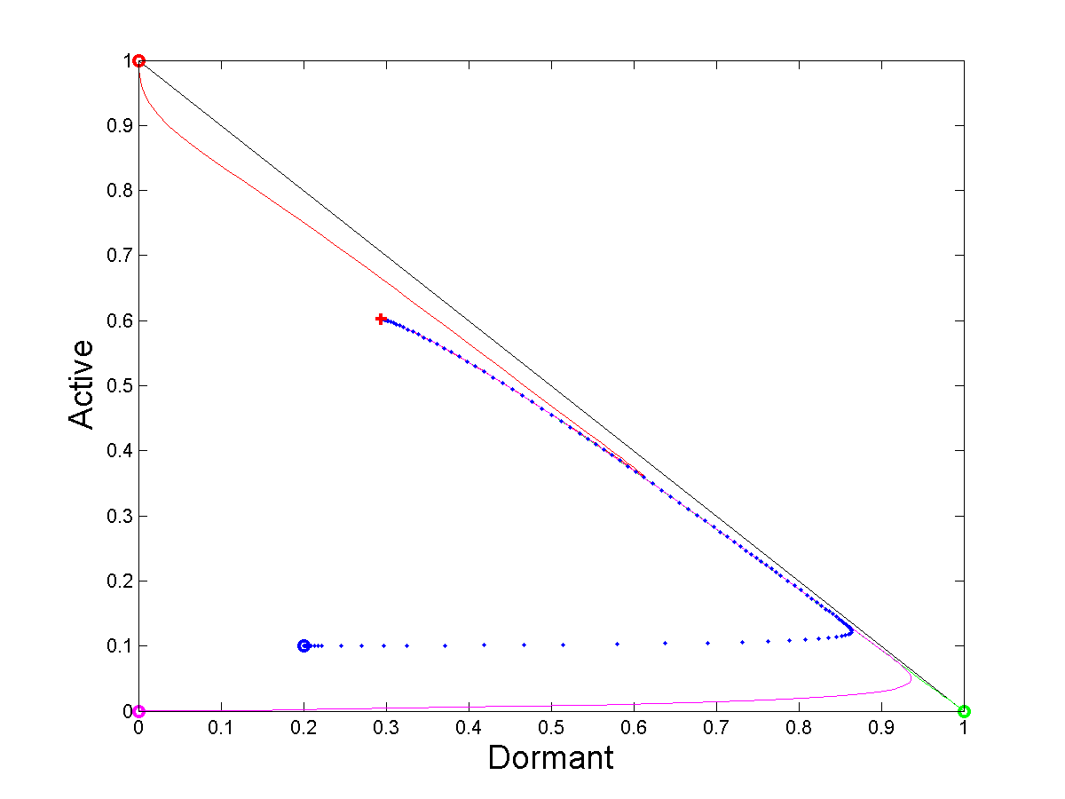
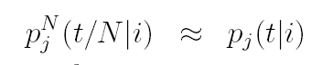
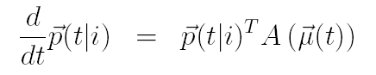
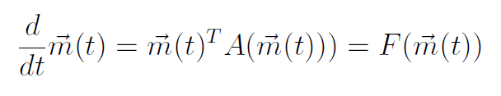
2-Step Malware Example
p^{N}_{j}(t|i) is the probability that a node that starts in state i is in state j at time t:
Then
where p(t|i) is a continuous time, non homogeneous process
Same ODE as mean field limit, but with different initial condition
pdf of node 2
occupancy measure
μ(t)
pdf of node 3
pdf of node 1

Slide 44
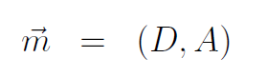
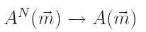
Details of the 2-Step Malware Example
P^{N}_{i,j} (m) is the marginal transition probability for one object, given that the state of the system is m
Note: Knowing the transition matrix P^{N} (m) is not enough to be able to simulate (or analyze) the system with N objects
Because there may be simultaneous transitions of several objects (on the example, up to 2)
However, the fast simulation says that, in the large N limit, we can consider one (or k) objects as if they were independent of the other N-k
(X^{N}₁(t/N), M^{N}(t/N)) can be approximated by the process (X₁(t), m(t)) where m(t) follows the ODE and X₁(t) is a jump process with time-dependent transition matrix A(m(t)) where

Slide 45
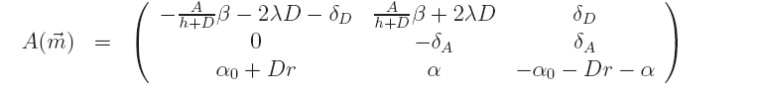
A^{N}
The state of one object is a jump process with transition matrix: where m = (D, A, S) depends on time (is solution of the ODE)

Slide 46
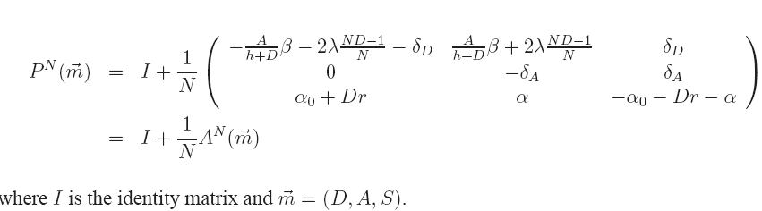
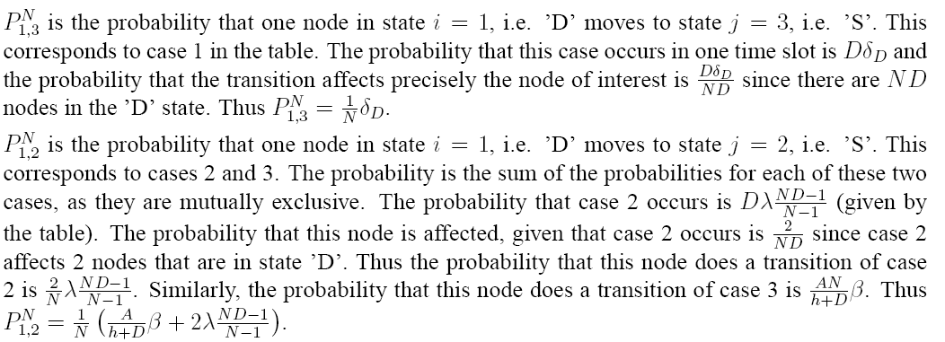
Computing the Transition Probability
P^{N}_{i,j} (m) is the transition probability for one object, given that the state if m

Slide 47
The Two Interpretations of the Mean Field Limit
m(t) is the approximation for large N of
the occupancy measure M^{N}(t)
the state probability for one object at time t, drawn at random among N
The state probability for one object at time t, known to be in state i at time 0, follows the same ODE as the mean field limit, but with different initial condition

Slide 48
STATIONARY REGIME OF mean Field Limit
STATIONARY REGIME

Slide 49
Stationary Regimes
Original process is random, assume it has a unique stationary regime
The mean field limit is deterministic;
Q: What is the stationary regime for a deterministic process ?

Slide 50
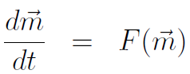
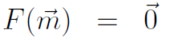
Frequent Answer
Mean field limit :
Stationary regime

Slide 51
Example
Same as before except for one parameter value : h = 0.1 instead of 0.3
The ODE does not converge to a unique attractor (limit cycle)
The equation F(m) = 0 has a unique solution (red cross)

Slide 52
CRITIQUE OF FIXED POINT Method
STATIONARY REGIME

Slide 53
The Fixed Point Method
A generic method, sometimes implicitly used
Method is as follows:
Assume many interacting objects, focus on one object
Pretend this and other objects have a state distributed according to some proba m
Pretend they are independent
Write the resulting equation for m (a fixed point equation) and solve it, assumption
Can be interpreted as follows
Assume a mean field interaction model, converges to mean field
Propagation of chaos => objects are asymptotically independent

Slide 54
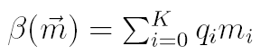
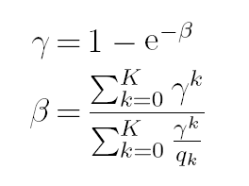
Example: 802.11 Analysis, Bianchi’s Formula
802.11 single cell
m_{i} = proba one node is in backoff stage I
β= attempt rate
γ = collision proba
See [Benaim and Le Boudec , 2008] for this analysis
Solve for Fixed Point:
Bianchi’s
Fixed
Point
Equation
[Bianchi 1998]

Slide 55
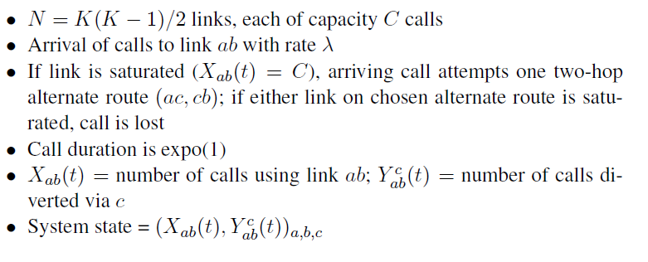
Example: Kelly’s Alternate Routing [Kelly, 1991]
This is not a mean field interaction model
If we rename object ab we need to rename obejct abc accordingly
However,there is convergence to a deterministic occupancy measure and propagation of chaos [e.g. Graham and Méléard 1997]
d
c
a
b

Slide 56
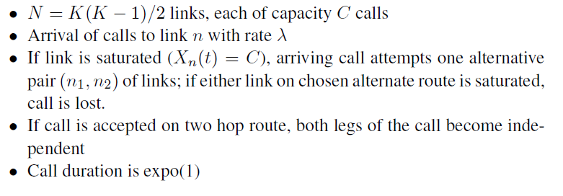
Kelly’s Alternate Routing Simplified Model
This is a mean field interaction model, has same limiting equations as original limit.
d
c
a
b

Slide 57
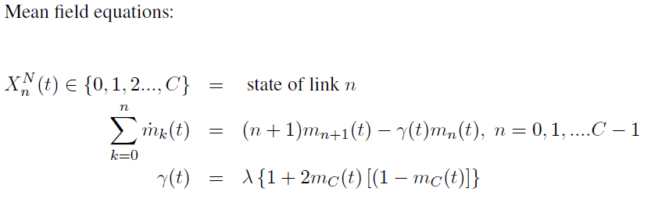
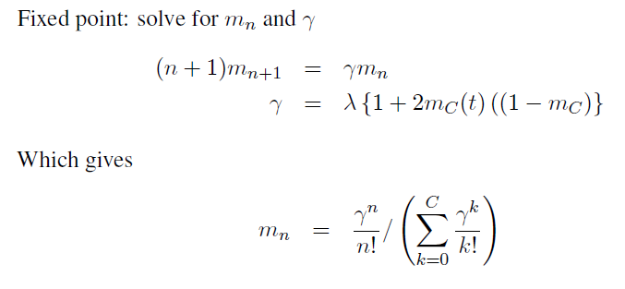

Slide 58
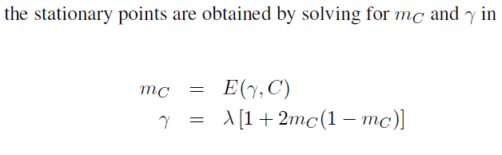
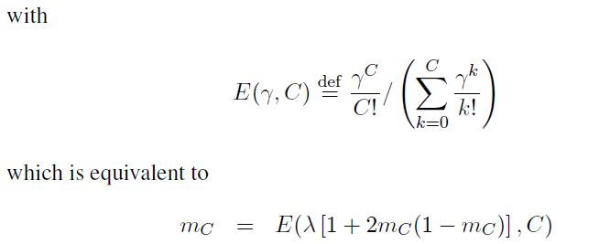
Fixed Point Equation for
saturation
prob m_{C}

Slide 59
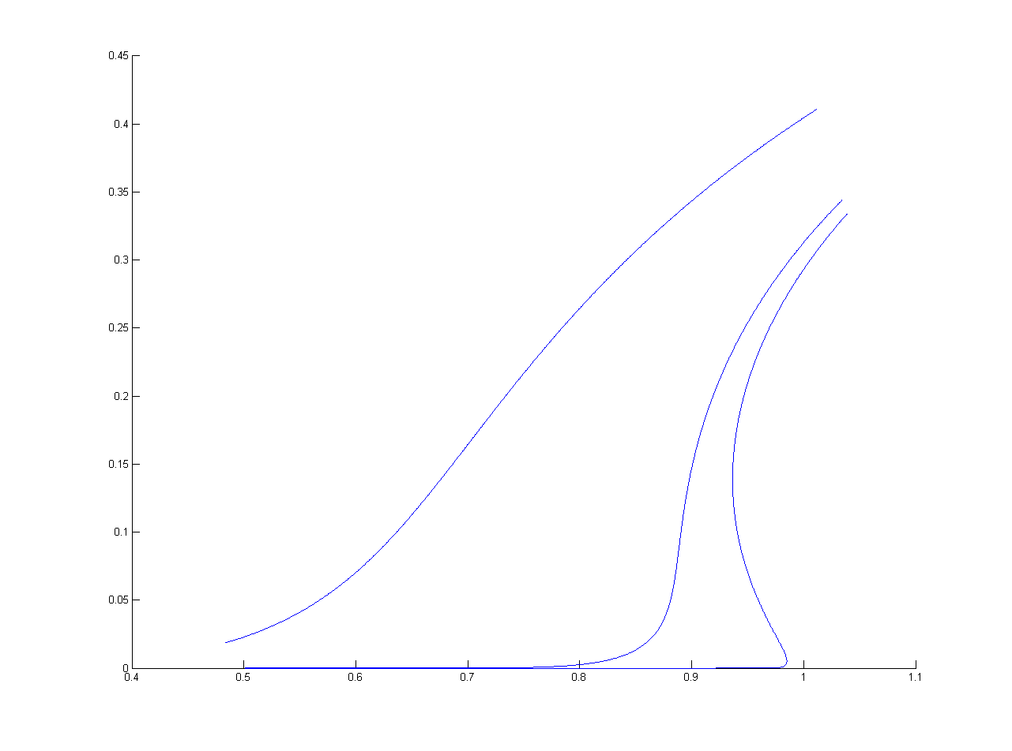
m_{C}
C=120
C=10
C=10000
non unique fixed point
λ/C

Slide 60
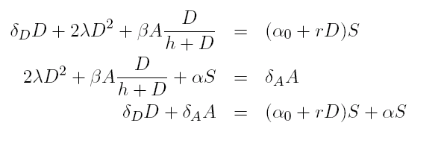
Fixed Point Method Applied to 2-Step Malware Example
Recovery
D -> S
Mutual upgrade
D + D -> A + A
Infection by active
D + A -> A + A
Recovery
A -> S
Recruitment by Dormant
S + D -> D + D
Direct infection
S -> A
Solve for (D,A,S)
Has a unique solution

Slide 61
Example Where Fixed Point Method Succeeds
In stationary regime:
Prob (node n is dormant) ≈ 0.3
Prob (node n is active) ≈ 0.6
Prob (node n is susceptible) ≈ 0.1
Nodes m and n are independent
The diagram commutes
h=0.3
t -> +1
Law of M^{N}(t)
ϖ^{N}
N -> +1
N -> +1
δ_{μ(t)}
δ_{m*}
t -> +1

Slide 62
Example Where Fixed Point Method Fails
In stationary regime, m(t) = (D(t), A(t), S(t)) follows the limit cycle
Assume you are in stationary regime (simulation has run for a long time) and you observe that one node, say n=1, is in state ‘A’
It is more likely that m(t) is in region R
Therefore, it is more likely that some other node, say n=2, is also in state ‘A’
This is synchronization
R
h=0.1

Slide 63
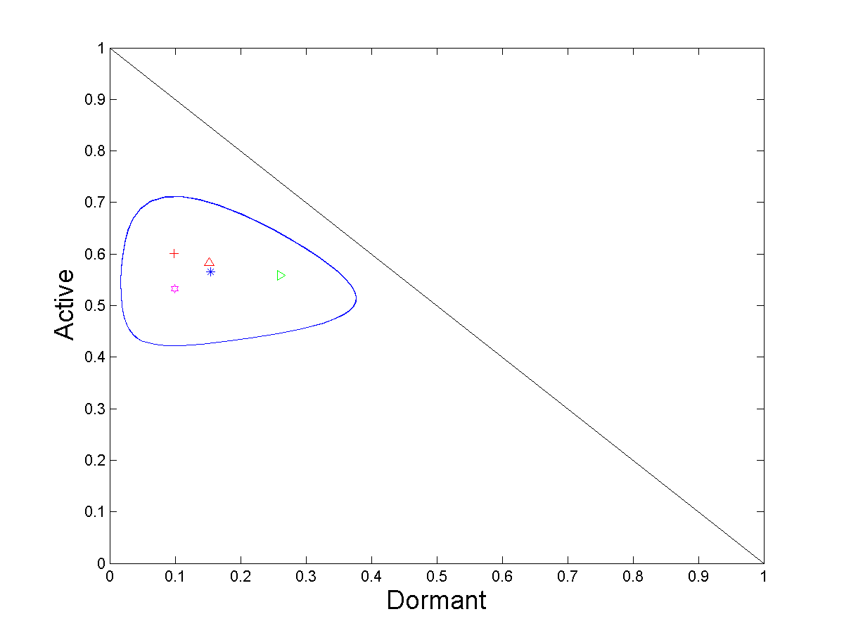
Joint PDFs of Two Nodes in Stationary Regime
Stationary point of ODE
Mean of Limit of ϖ^{N} = pdf of one node in stationary regime
pdf of node 2 in stationary regime, given node 1 is A
pdf of node 2 in stationary regime, given node 1 is D
pdf of node 2 in stationary regime, given node 1 is S

Slide 64
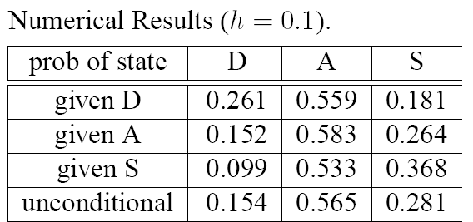
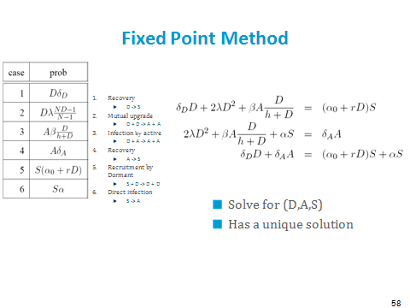

Slide 65
Where is the Catch ?
Mean field convergence implies that nodes m and n are asymptotically independent
There is mean field convergence for this example
But we saw that nodes may not be asymptotically independent
… is there a contradiction ?

Slide 66
Markov chain is ergodic
Mean Field
Convergence
???
Mean Field convergence implies asymptotic Independence in Transient Regime, but says nothing about Stationary Regime
We have three general results

Slide 67
Result 1: Fixed Point Method Holds under (H)
Assume that
(H) ODE has a unique global stable point to which all trajectories converge
Theorem [e.g. Benaim et al 2008] : The limit of stationary distribution of M^{N} is concentrated on this fixed point
i.e., under (H), the fixed point method and the decoupling assumptions are justified
Uniqueness of fixed point is not sufficient
(H) has nothing to do with the properties at finite N
In our example, for h=0.3 the decoupling assumption holds in stationary regime, for h=0.1 it does not
In both cases the Markov chain at finite N has the same graph.
Study the ODE !

Slide 68
The Diagram Does Not Always Commute
h=0.1
For large t and N: where T is the period of the limit cycle

Slide 69
Result 2 for Stationary Regime
Original system (stochastic):
(X^{N}(t)) is Markov, finite, discrete time
Assume it is irreducible, thus has a unique stationary proba ν^{N}
Let ϖ^{N} be the corresponding stationary distribution for M^{N}(t), i.e. P(M^{N}(t)=(x₁,…,x_{I})) = ϖ^{N}(x₁,…,x_{I}) for x_{i} of the form k/n, k integer
Theorem [Benaim] Birkhoff Center: closure of set of points s.t. m∊ ω(m) Omega limit: ω(m) = set of limit points of orbit starting at m

Slide 70
Here: Birkhoff center = limit cycle  fixed point
The theorem says that the stochastic system for large N is close to the Birkhoff center, i.e. the stationary regime of ODE is a good approximation of the stationary regime of stochastic system

Slide 71
Existence and Unicity of a Fixed Point are not Sufficient for Validity of Fixed Point Method
Essential assumption is
(H) m(t) converges to a unique m*
It is not sufficient to find that there is a unique stationary point, i.e. a unique solution to F(m*)=0
Counter Example on figure
(X^{N}(t)) is irreducible and thus has a unique stationary probability η^{Ν}
There is a unique stationary point ( = fixed point ) (red cross)
F(m*)=0 has a unique solution
but it is not a stable equilibrium
The fixed point method would say here
Prob (node n is dormant) ≈ 0.1
Nodes are independent
… but in reality
We have seen that nodes are not independent, but are correlated and synchronized

Slide 72
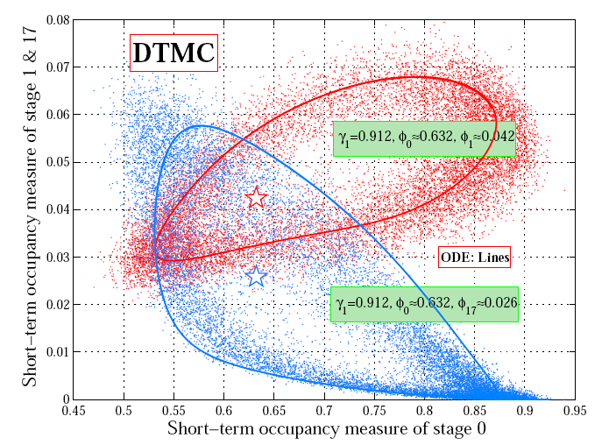
Example: 802.11 with Heterogeneous Nodes
[Cho2010] Two classes of nodes with heterogeneous parameters (restransmission probability) Fixed point equation has a unique solution There is a limit cycle

Slide 73
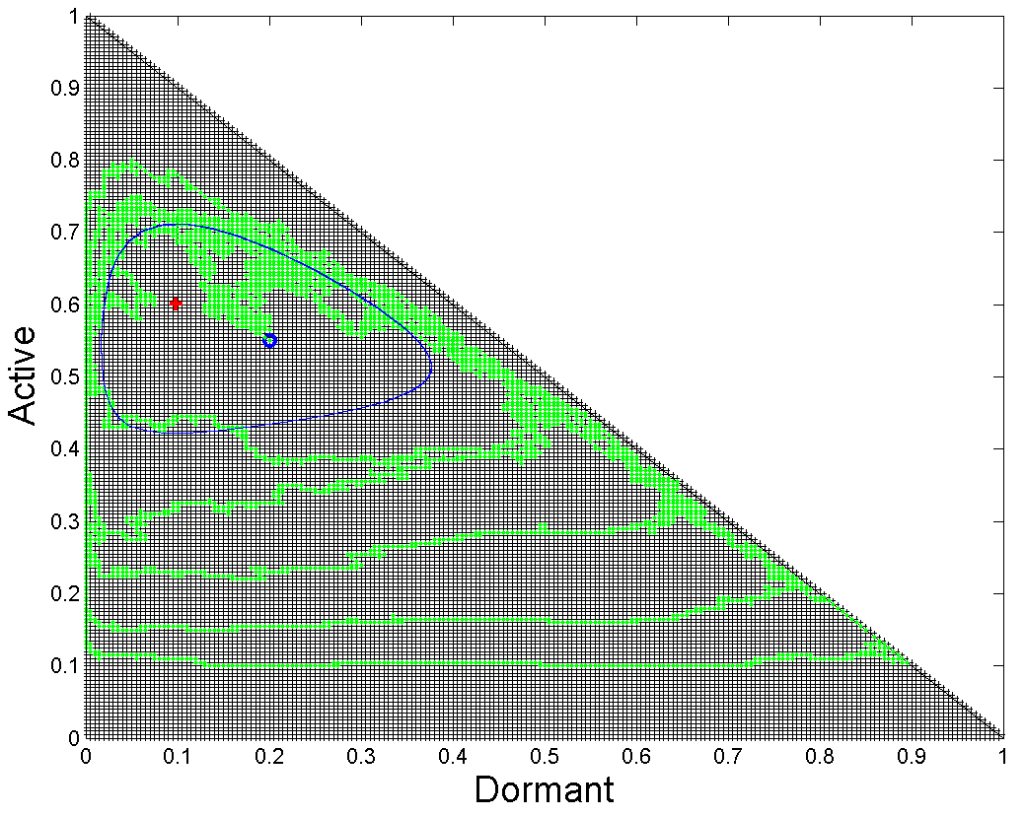
Quiz
M^{N}(t) is a Markov chain on E={(a, b, c) ¸ 0, a + b + c =1, a, b, c multiples of 1/N}
A. M^{N}(t) is periodic, this is why there is a limit cycle for large N.
B. For large N, the stationary proba of M^{N} tends to be concentrated on the blue cycle.
C. For large N, the stationary proba of M^{N} tends to a Dirac.
D. M^{N}(t) is not ergodic, this is why there is a limit cycle for large N.
E (for N = 200)

Slide 74
REVERSIBLE CASE
STATIONARY REGIME

Slide 75
Result 3: Reversible Case
Definition Markov Process X(t) on enumerable state E space, with transition rates q(i,j) is reversible iff
It is ergodic
There exists some probability distribution p such that, for all i, j in E
p(i) q(i,j) = p(j) q(j,i)
If X(t) is reversible iff
It is stationary (strict sense)
It has same process law under reversal of time
Most processes are not reversible, but some interesting cases exist:
Product form queuing networks with reversible routing matrix (e.g, on a bus)
Kelly’s alternate routing models

Slide 76
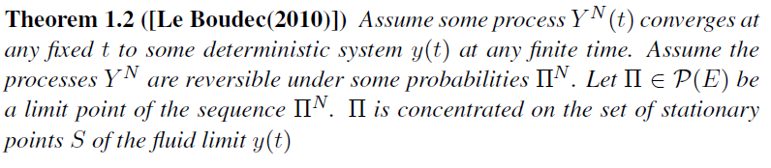
Result 3: Reversible Case
Stationary points = fixed points
If process with finite N is reversible, the stationary behaviour is determined only by fixed points.
Even if (H) does not hold

Slide 77
Example: Kelly’s Alternate Routing
System with N nodes is reversible
Kelly’s analysis looks for fixed points only
Justified by reversibility
Saturation prob
m_{C}
d
C=120
c
C=10
C=10000
a
b
λ/C

Slide 78
OPTIMIZATION

Slide 79
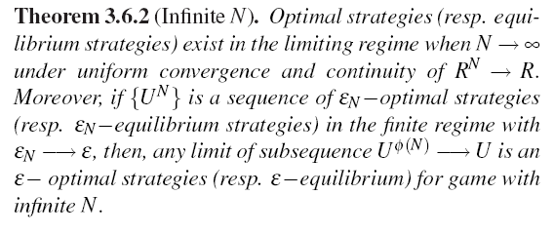
Decentralized Control
Game Theoretic setting; N players, each player has a class, each class has a policy; each player also has a state;
Set of states and classes is fixed and finite
Time is discrete; a number of players plays at any point in time.
Assume similar scaling assumptions as before.
[Tembine et al.(2009)] For large N the game converges to a single player game against a population;

Slide 80
Optimal, Centralized Control
[Gast et al.(2010)]
Markov decision process (MDP)
Finite state space per object, discrete time, N objects
Transition matrix depends on a control policy
For large N the system control converges to mean field, under any control
Mean field limit
ODE driven by a control function
Theorem: under similar assumptions as before, the optimal value function of MDP converges to the optimal value of the limiting system
The result transforms MDP into fluid optimization, with very different complexity

Slide 81
Conclusion
Mean field models are frequent in large scale systems
Mean field is much more than a fluid approximation: decoupling assumption / fast simulation / random process modulated by fluid limit
Decoupling assumption holds at finite horizon; may not hold in stationary regime.
Stationary regime is more than stationary points, in general
(except for reversible case)
Control on mean field limit may give new insights

Slide 82
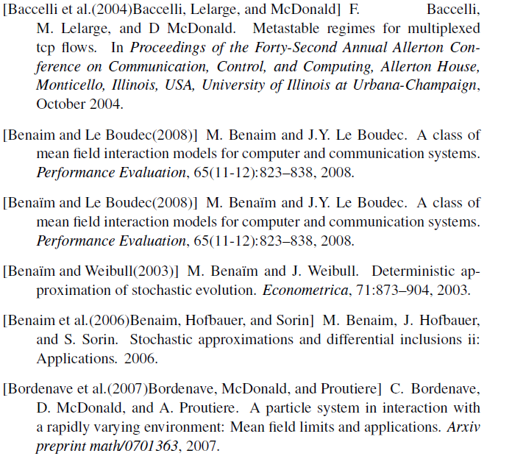
References

Slide 83



Slide 84

2

Slide 85



Slide 86


